Slide 1




Workshop on R and movement ecology:
Hong Kong University, Jan 2018
Eric Dougherty, Dana Seidel, Wayne Getz
Lecture 2
Introduction to Movement Ecology

Slide 2
On the Movements of Animals
“The movement of animals that belong to each genus, and how these are differentiated, and what the reasons are for the accidental characteristics of each—all this we have considered elsewhere. But now we must consider in general the common reason for moving with any movement whatever (for some animals move by flying, some by swimming, some by stepping, some in other comparable ways)”
-Aristole, De Motu Animalium (~300 B.C.)

Slide 3
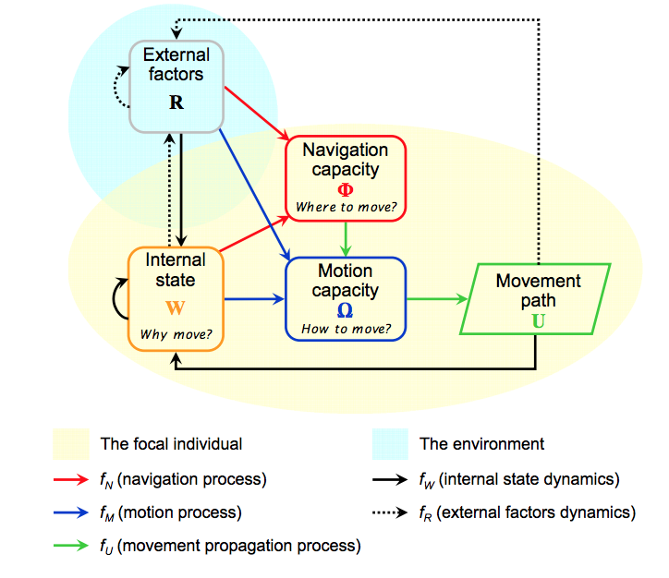
Movement Ecology Paradigm
Nathan et al. 2008; PNAS

Slide 4
Four Fundamental Components
Internal State – the question of whether or not to move is dictated in large part by the internal needs and motivations of an animal
Motion Capacity – The biomechanical elements that enable or preclude an animal from making particular movements
Navigational Capacity – the ability to determine a direction and speed of movement will emerge largely from memory and perception
External Factors – the environment (resources, predators, competition, etc.) will expand or reduce possible movements

Slide 5
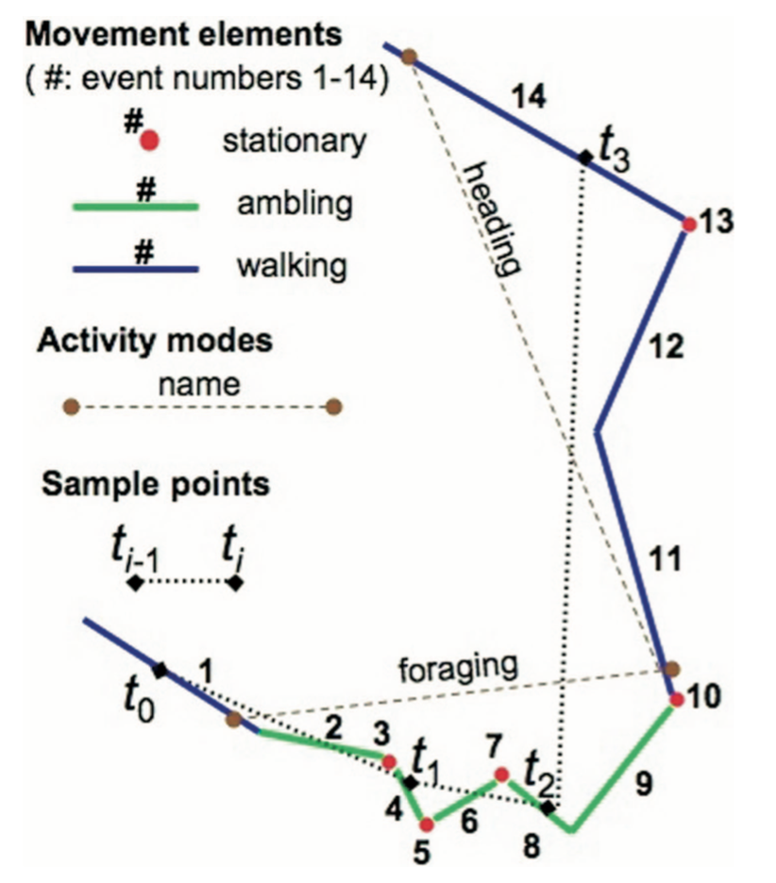
Measuring Movement
Fundamental Movement Elements (FMEs) – extremely fine-scale motor movements that comprise all movements, such as a lunge versus a step taken at normal speed
Canonical Activity Modes (CAMs) – distributions that emerge from the mix of FMEs that characterize the activity in question, such as foraging
Getz & Saltz 2008; PNAS

Slide 6
Types of Movement Data
Irregular interval data
Direct observation; Very High Frequency (VHF) telemetry; Autonomous arrays; Genetic profiles.
Regular interval data
GPS monitoring; new tags may even include video, photo, or proximity capabilities
Complementary data sources
Accelerometers, altimeters, physiological metric monitors

Slide 7
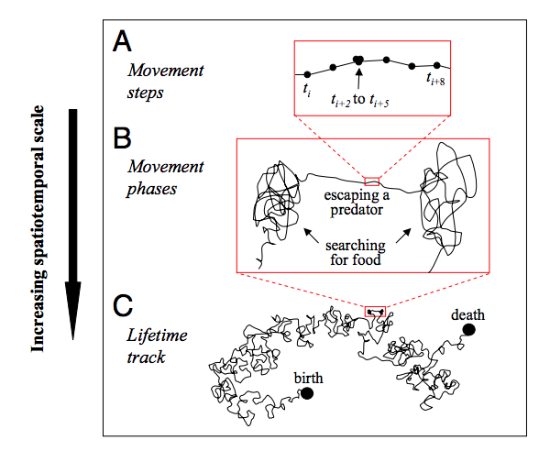
Scales of Movement Analysis

Slide 8
Questions we ask in ME
Questions of Animal Behavior
Questions of landscape structure and function

Slide 9
Applications
Understanding land use
Evaluating the impact of global climate and land use change on animal populations
Predicting/Preventing human-wildlife conflict
Understanding social structure
Understanding territoriality
Understanding landscape connectivity
Predicting range shifts
Predicting disease outbreak/risk/spread
Evaluating gene flow

Slide 10
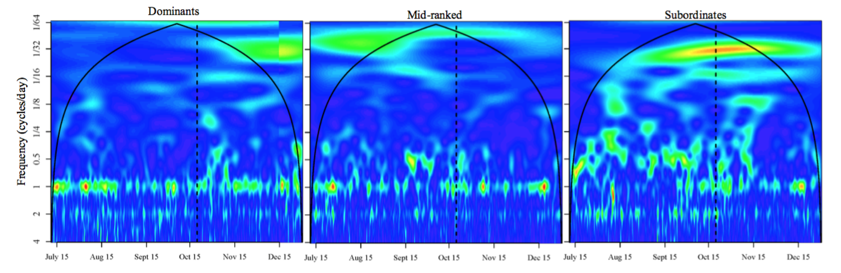
Wittemeyer et al. 2008
A fascinating and inventive use of movement analysis applied wavelet methods to identify dominant frequencies in autocorrelation of elephant steps
They recognized that they could separate dominant individuals from mid-ranked and subordinate individuals based on the frequency of forays to watering holes.

Slide 11
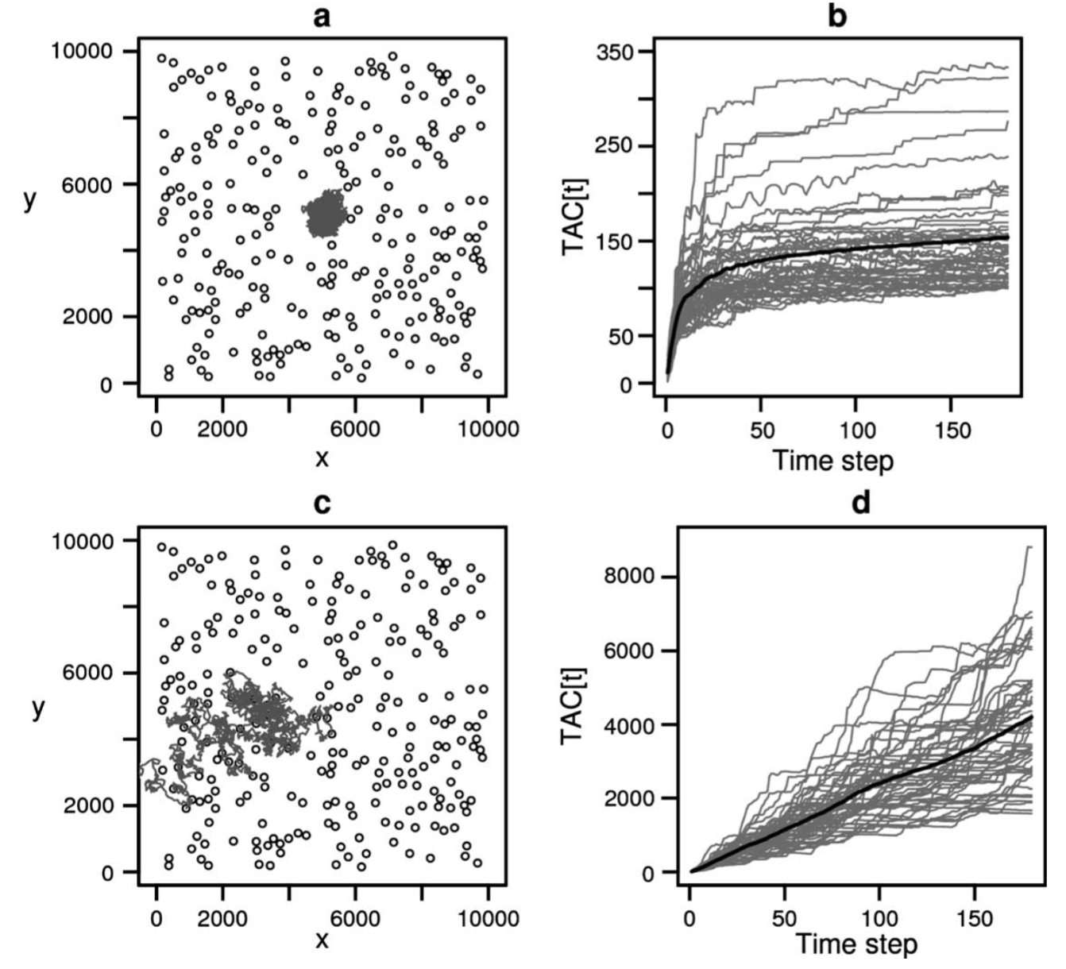
Van Moorter et al. 2009
A stochastic movement simulation model was used to explore the potential mechanisms underlying home range formation in natural systems
Using two forms of memory (reference and working), home ranges were induced in a set of random walkers

Slide 12
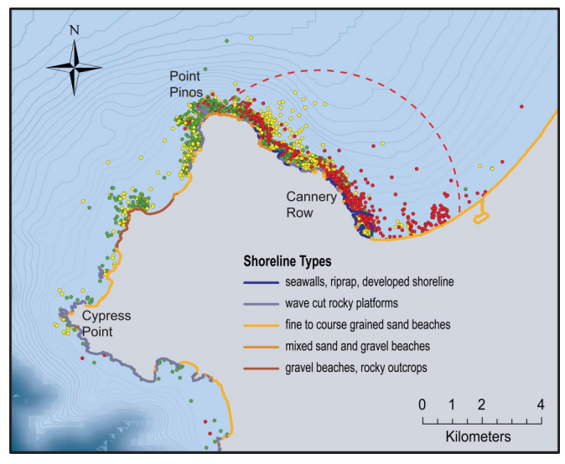
Johnson et al. 2009
Used radiocollars on sea otters to explore the connection between disparate resource exploitation strategies and infection dynamics
Found that otters in resource-rich areas fed on abalone and had much lower infection prevalence than those in resource-poor regions feeding on marine snails

Slide 13
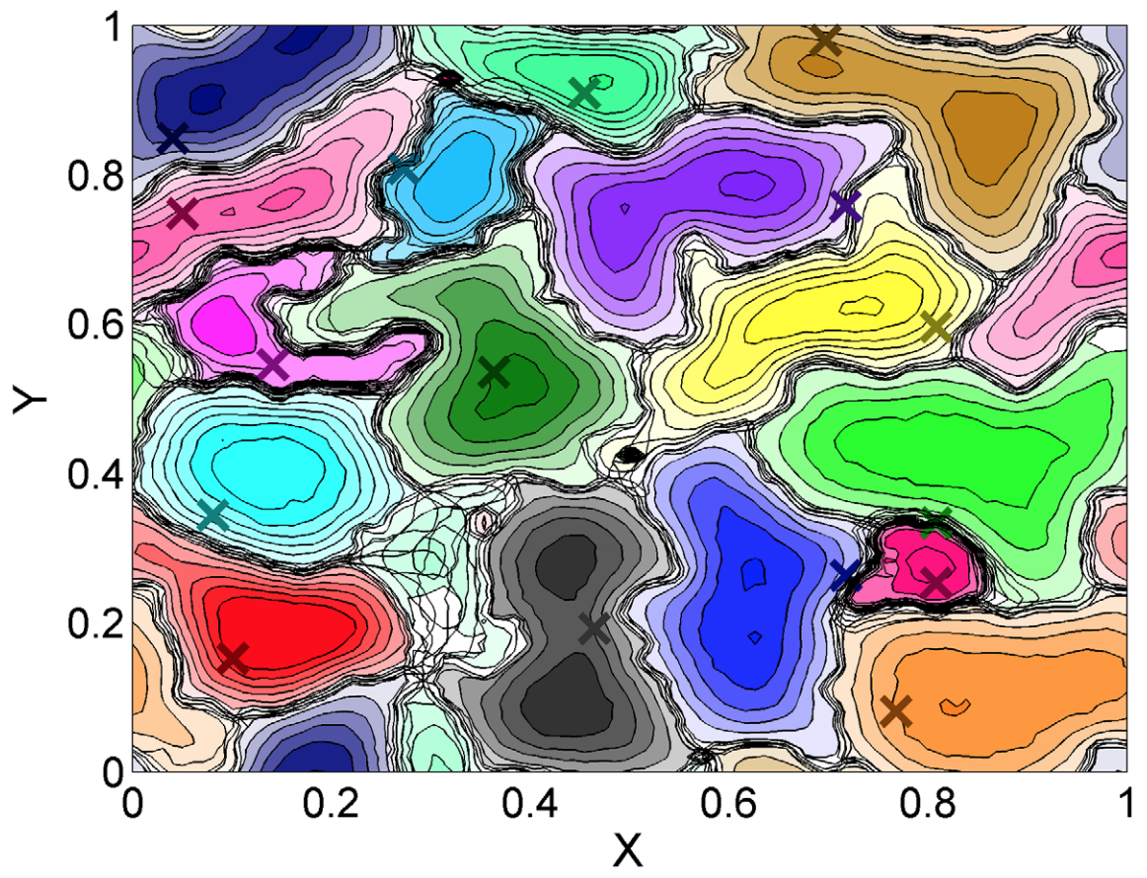
Giuggioli et al. 2011
In another example of a mechanistic simulation model, the authors explored the emergence of territoriality in wild populations like the red fox
Using simple rules to represent scent-marking dynamics, territory boundaries were established and maintained between individuals

Slide 14
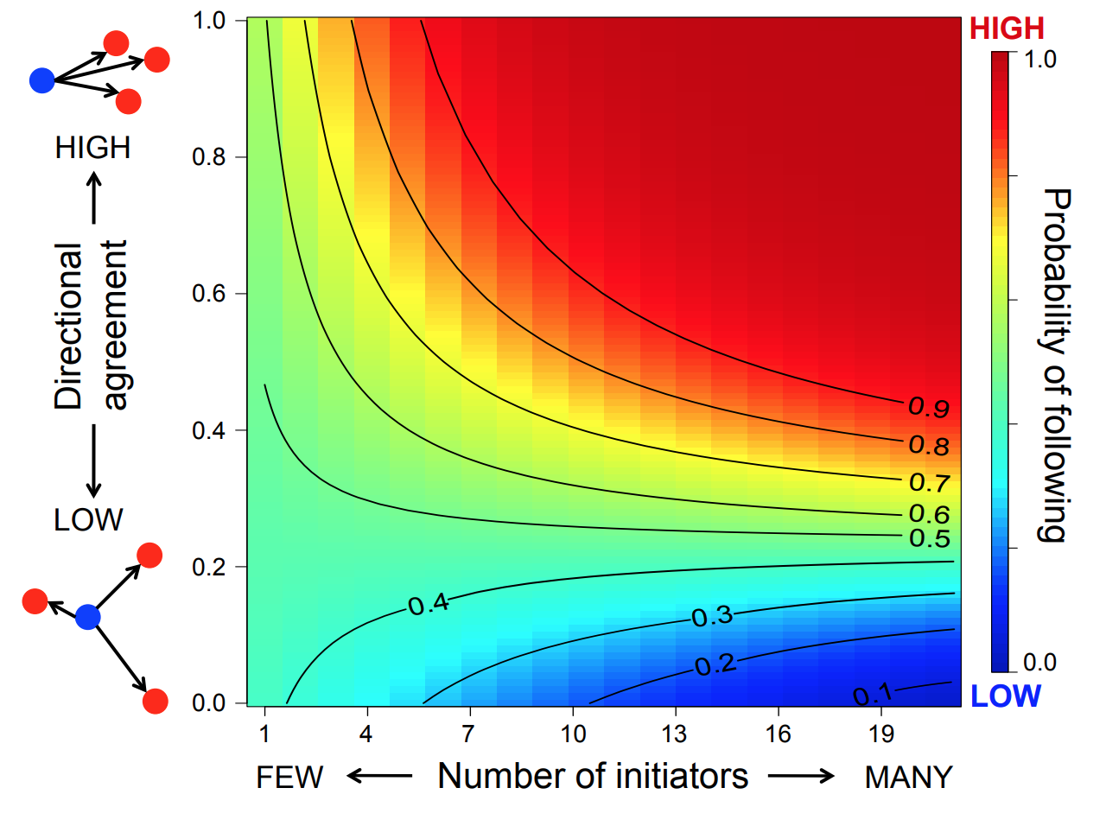
Strandburg-Peshkin et al. 2015
Extremely high resolution movement data was collected from every adult individual in a troop of baboons
Found that decisions regarding group movement were more likely to be democratic (i.e., movements were frequently induced by multiple individual at once) rather than autocratic (i.e., following a single dominant individual)

Slide 15
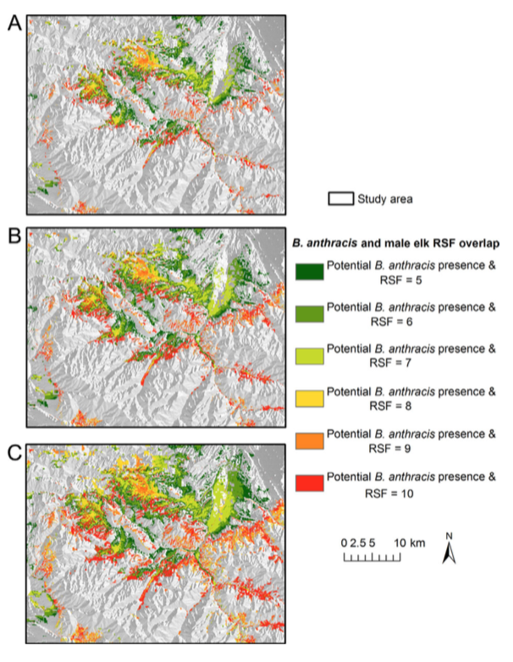
Morris et al. 2016
Developed a model to predict the location of elk throughout the anthrax season on a ranch in Montana and assessed the risk of exposure they faced
Found that there were extensive regions of overlap between habitat selected by elk and areas with environmental features conducive to maintaining anthrax

Slide 16
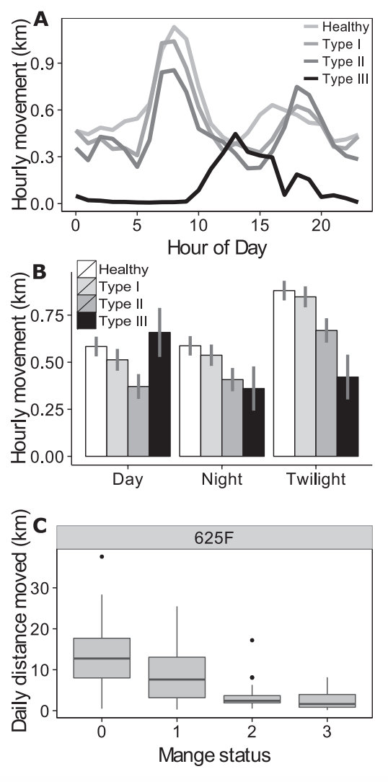
Cross et al. 2016
Deployed GPS collars on a population of wolves containing individuals infected with sarcoptic mange
Found that mange had notable impacts on the daily movements of individuals, with later stages of infection reducing total distance more than earlier stages. In addition, infected wolves spent significantly less time in an active behavioral mode than healthy wolves

Slide 17
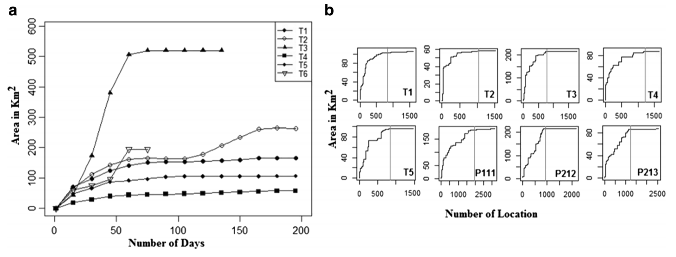
Sarkar et al. 2016
The reintroduction of tigers to a protected area in India offered an ideal opportunity to examine the manner by which individuals establish home ranges
Found that all of the tigers established home ranges following a short exploratory phase, and they all demonstrated a high level of site fidelity once established

Slide 18
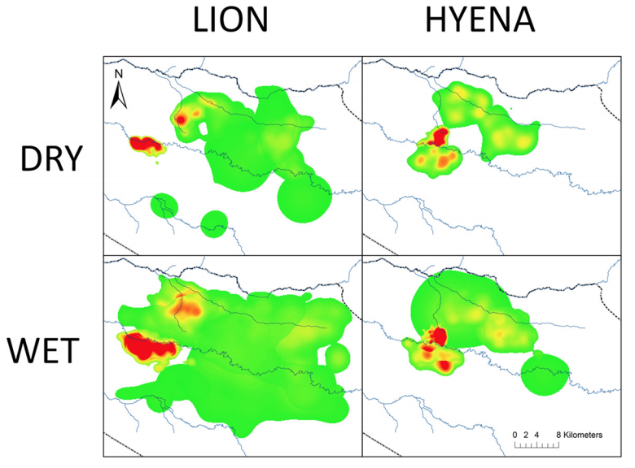
Kittle et al. 2016
Used movement data to analyze the role of landscape features, prey availability, and competition in determining the distribution of large carnivores
Found that lions were uninhibited by their competitors (hyenas), but that prey availability and habitat both influenced the distribution of lions across the Serengeti

